Slide 1
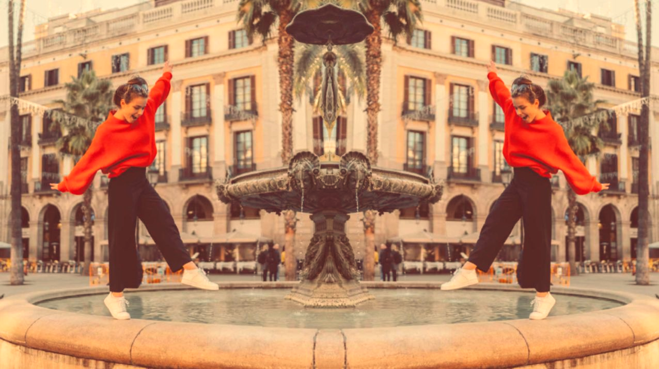
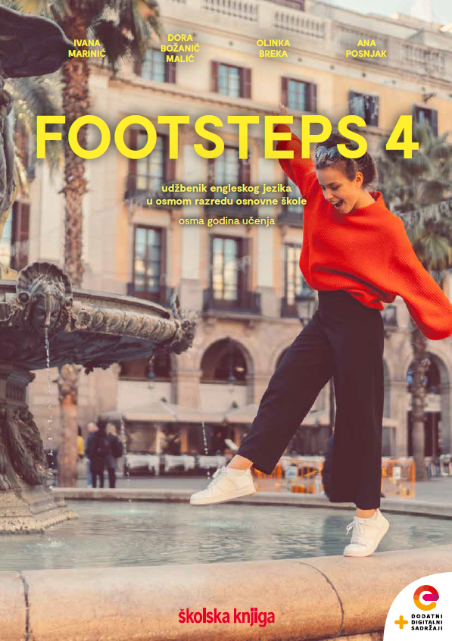

UNIT 1; All too human
Lesson 1; Dream team

Slide 2
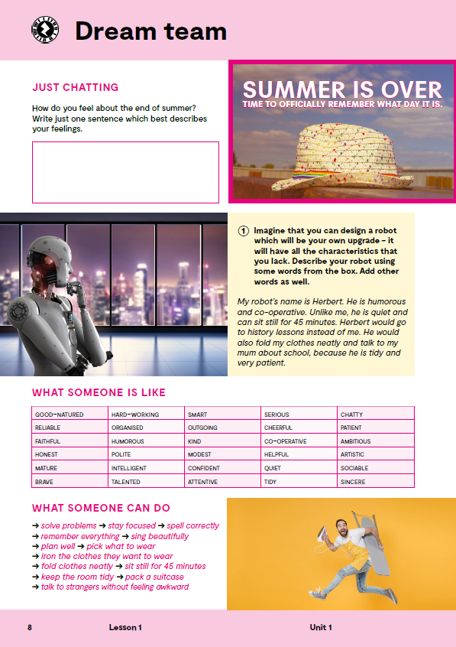

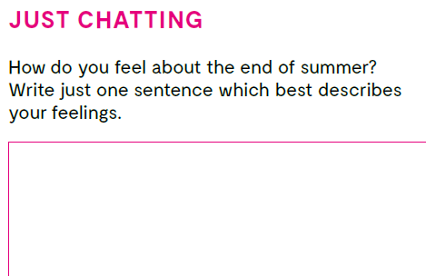
Summer is over, Time to offically remember what day it is.
How did you spend your summer??
How do you feel about the end of summer?
Write just one sentence which best describes your feelings.

Slide 3
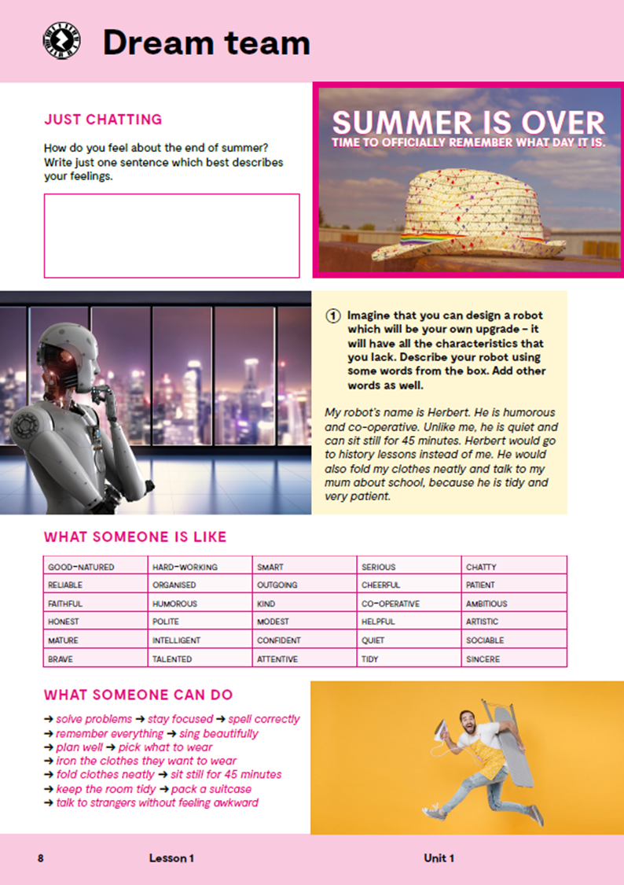
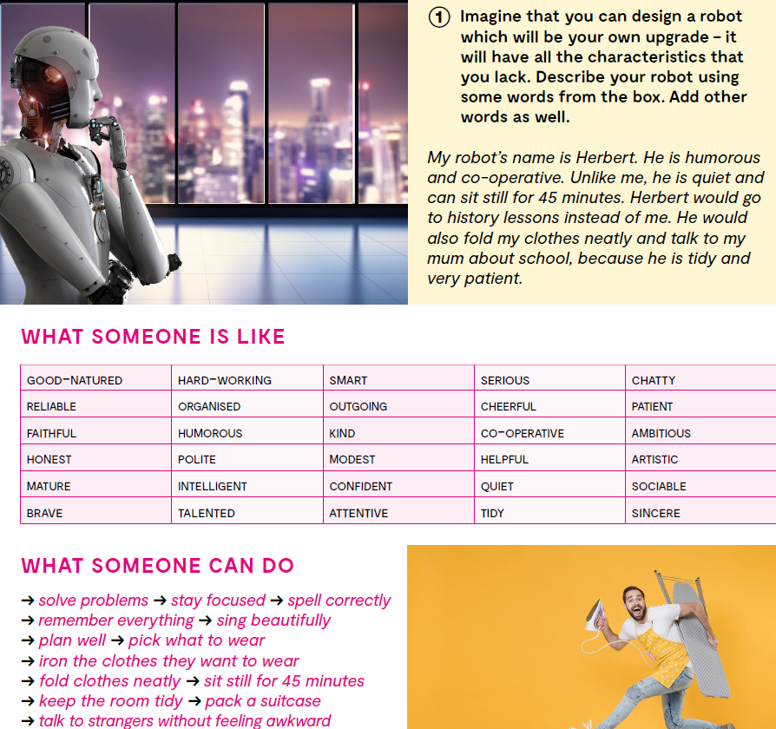
Imagine that you can design a robot which will be your own upgrade – it will have all the characteristics that you lack. Describe your robot using some words from the box. Add other words as well.
Do you know the meaning of all the words?

Slide 4
reliable
faithful
outgoing
modest
confident
attentive
sincere
iron the clothes
fold clothes neatly
pouzdan
vjeran
društven
skroman
samouvjeren
pažljiv
iskren
izglačati odjeću
uredno složiti odjeću

Slide 5
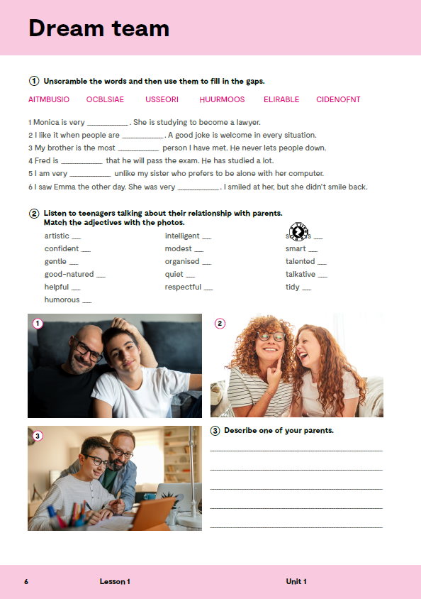
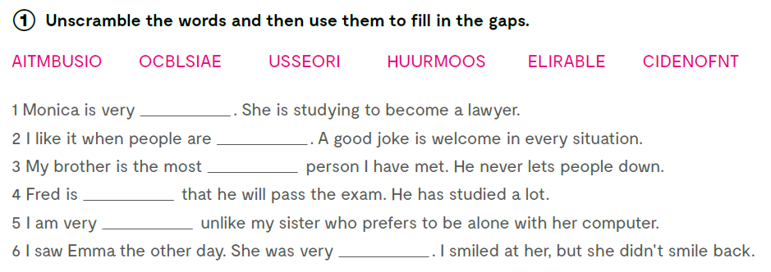
Open your exercise book, page 6.
Unscramble the words and then use them to fill in the gaps.
ambitious
humorous
reliable
confident
sociable
serious
Poveznice za uvježbavanje pridjeva: https://wordwall.net/play/11128/182/783
https://wordwall.net/play/11128/652/165

Slide 6

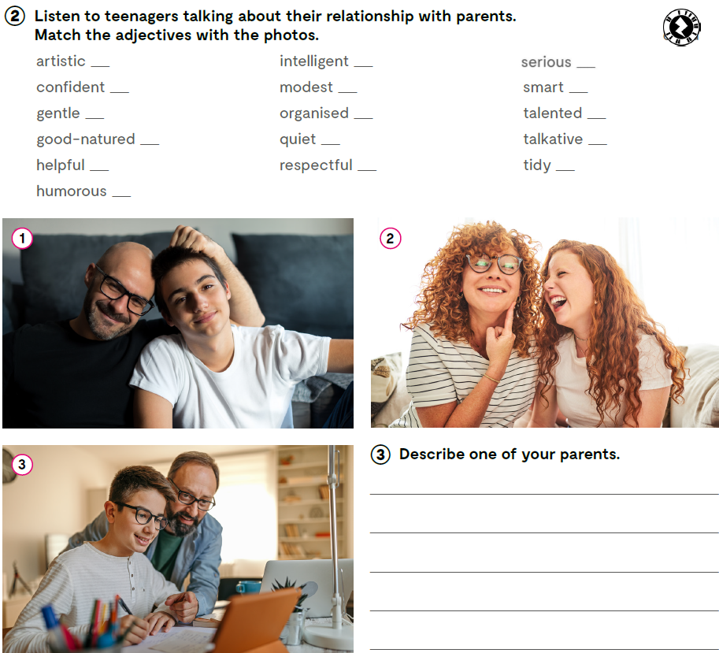
Teenagers are talking about their relationship with parents. Match the adjectives with the photos. 1 My father is very gentle and good-natured. He talks to me a lot, sometimes even too much. From time to time I stare through the window at our back yard because it helps me concentrate. Whenever he sees me do that, he starts asking millions of questions. I am not really a talkative person so I don't feel like explaining everything I feel. But still, the fact that I can tell him everything makes me feel more confident about myself.
2 My mother is a very cheerful person. She is humorous and makes everybody laugh. On the other hand, she is sometimes very quiet. She has a little studio in which she paints for two hours every day. It is very tidy. Her paintings are strange, but everybody says that she is very talented. I am obviously not an artistic type, and I don't understand abstract art.
3 My father is very helpful. He helps mum around the house and he helps me and my brothers with their homework. I am quite intelligent – I know that this doesn't sound very modest – and I usually don’t need his help. But my father is really smart and organised, so he is the one I turn to whenever there is a problem. I'd like him to be less serious sometimes, but I've learnt that I need to be respectful of other people's character.
2
3
3
1
3
3
1
3
2
1
2
1
3
3
2
2

Slide 7

2
3
3
1
3
3
1
3
2
1
2
1
3
3
2
2
Describe one of your parents.

Slide 8
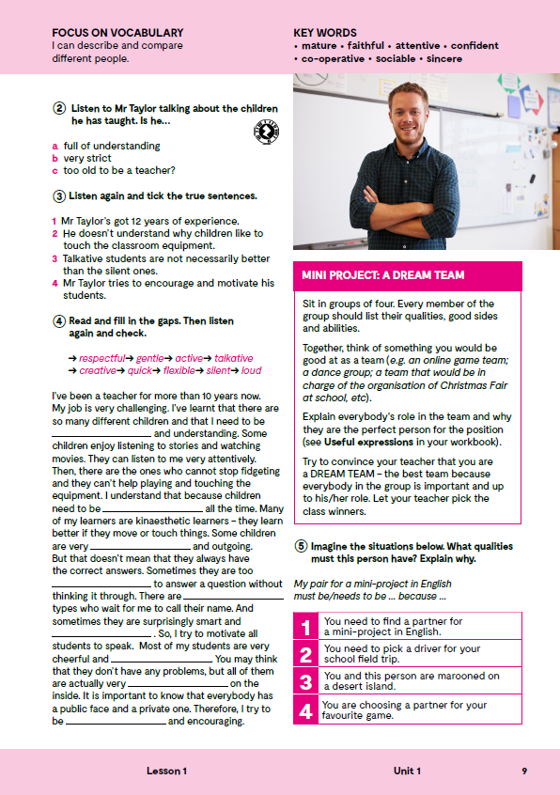
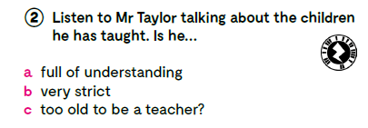


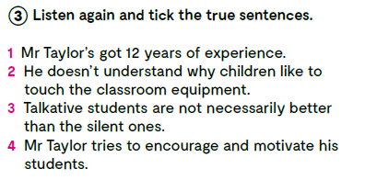

Open your book, page 9.
Listen to Mr Taylor talking about the children he has taught. Is he… a) full of understanding, b) very strict, c) too old to be a teacher? https://www.e-sfera.hr/dodatni-digitalni-sadrzaji/75d61888-8ccb-4921-8b36-bcf9a7c131b7/assets/audio/01_unit_1__lesson_1__exercise_2-4.mp3
Listen again and tick the true sentences. https://www.e-sfera.hr/dodatni-digitalni-sadrzaji/75d61888-8ccb-4921-8b36-bcf9a7c131b7/assets/audio/01_unit_1__lesson_1__exercise_2-4.mp3

Slide 9

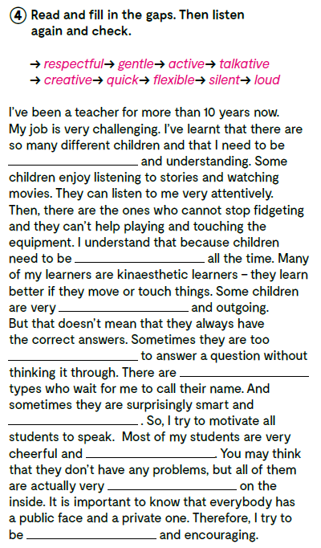
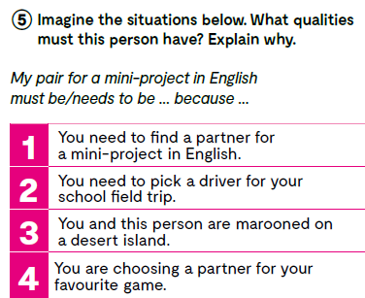
Read and fill in the gaps. Then listen again and check. https://www.e-sfera.hr/dodatni-digitalni-sadrzaji/75d61888-8ccb-4921-8b36-bcf9a7c131b7/assets/audio/01_unit_1__lesson_1__exercise_2-4.mp3
flexible
active
Imagine the situations below. What qualities must this person have? Explain why.
talkative
quick
silent
creative
loud
gentle
respectful

Slide 10
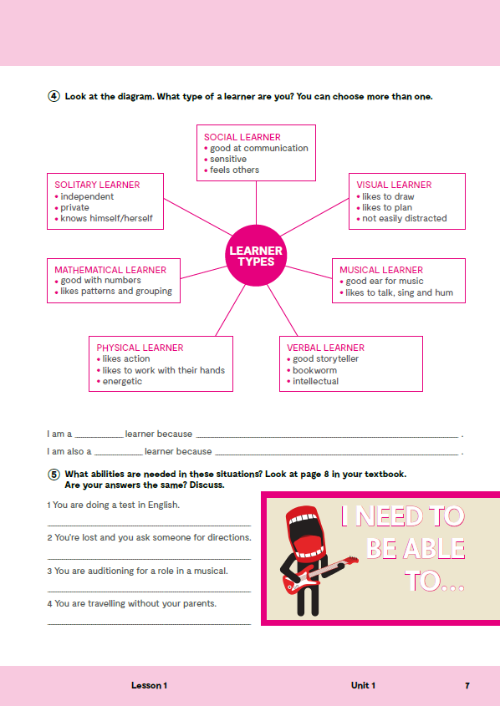
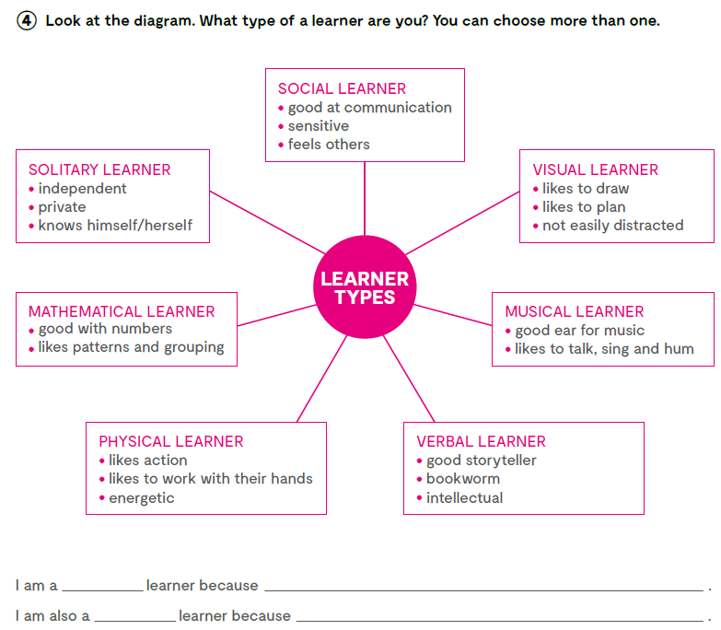
Look at the diagram. What type of a learner are you? You can choose more than one.

Slide 11
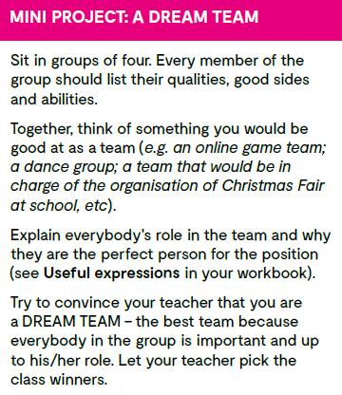
Make teams of four students and then choose one of the online collaboration tools. Every member of the group should list their qualities, good sides and abilities.
Together, think of something you would be good at as a team (e.g. an online game team; a dance group; a team that would be in charge of the organisation of Christmas Fair at school, etc). Explain everybody's role in the team and why they are the perfect person for the position (see Useful expressions in your workbook).
Try to convince your teacher that you are a DREAM TEAM – the best team because everybody in the group is important and up to his/her role. Let your teacher pick the class winners.

Slide 12
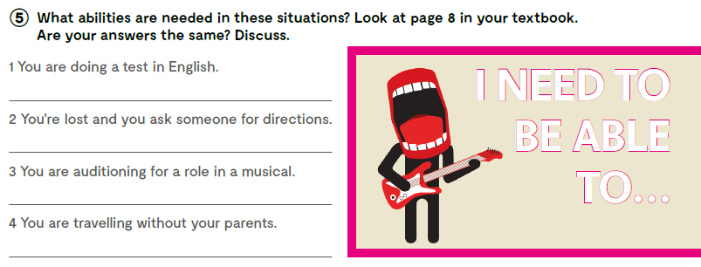
What abilities are needed in these situations? Look at page 8 in your textbook.

Slide 13

LEARN MORE!
https://www.e-sfera.hr/dodatni-digitalni-sadrzaji/75d61888-8ccb-4921-8b36-bcf9a7c131b7/
So many dream teams!

